Slide 1

Foreign Trusts: Inbound to the US and Outbound
Prepared For
2025 Delaware Trust Conference
Prepared By
Gregg Homan, Naro Zimmerman, Jillian Williams
28 October 2025

Slide 2
Contents & Discussion
Introductions
History & Key Considerations
Gregg Homan – Head of Strategic Partnerships, JTC Group
Case Study #1
Jillian K Williams- SVP Senior Fiduciary Officer, The Northern Trust Company of DE
Case Study #2
Jillian K Williams- SVP Senior Fiduciary Officer, The Northern Trust Company of DE
Case Study #3
Naro Zimmerman – Deputy Head of Caribbean, JTC Group
Conclusion
Gregg Homan – Head of Strategic Partnerships, JTC Group

Slide 3
Practical Considerations and a Little History
USA v The WORLD – who is winning the RING
For decades, offshore jurisdictions such as Cayman, Guernsey, Jersey, The Bahamas have dominated the trust landscape like dynasty teams. They built deep benches of expertise, world-class legislation, and the agility to serve a truly global client base.
But then came the U.S. - Delaware, South Dakota and Nevada, building their own playbooks. They offered directed trusts, perpetual duration, asset protection, and tax efficiency, all under the comfort of U.S. legal infrastructure. Suddenly, the offshore market is now forced to compete.
Today, the competition is tied, and we’re heading into overtime. Clients aren’t loyal to one jersey anymore, they’re shopping for the best combination of control, confidentiality, and compliance.
The question isn’t “offshore or onshore?” it’s “which team can execute under pressure at the buzzer in game 7.”
Like the great NBA rivalries, what started as fierce competition has evolved into mutual respect. They may throw jabs on air, but off-screen they’re teammates in the same game: we keep fiduciary stewardship at its highest standard.
Offshore and U.S. trustees are starting to play that same way. Different styles, different systems but one shared goal: earning and preserving client trust in a changing world in an increasingly compliance driven world……until the current administration changes it . . .
Notes:
Chuck vs. Shaq, Magic vs. Bird, Bird vs. Dr. J, Jordon v Everyone.

Slide 4
Key Considerations
Practical – road Map for success
Practical Planning for international trusts – we will cover these post 2 case studies – keep an eye on these topics:
Legal
Assets
KYC
Planning
Removing the existing offshore trustee
Tax issues
Fiduciary Roles

Slide 5
Include Succession Planning in your Drafting
Case study #1
Trust established in 2008 by a foreign individual for the benefit of his foreign spouse during his lifetime
Grantor was also the Investment Advisor and the Director of the underlying Private Investment Company (PIC), which owned a portfolio of financial assets
No successor Investment Advisor was appointed in the Trust Agreement
The only party with the ability to appoint a new Director for the PIC was the directed Trustee
Upon Grantor’s death, trust was to terminate and distribute outright to 35 individuals
Who would direct the Trustee to dissolve the PIC?
Who would direct the Trustee to liquidate the portfolio for ease of distribution?

Slide 6
Understanding the Life Cycle of a Foreign Trust
Case study #2
Grantor establishes foreign grantor trust for the benefit of his niece and nephew during his lifetime and funds it with a PIC, owning a financial portfolio. The trust is to distribute outright upon his death.
The niece was appointed the Investment Advisor of the Trust.
Niece receives advice from a third party to domesticate the assets to avoid a potential tax regime change in the Grantor's home country. She then directs the Trustee to convert the offshore PIC into a domestic LLC.
Grantor dies and the assets in the LLC are now subject to U.S. estate tax, prior to any distributions.
Because there was no U.S. executor named, the U.S. Trustee was responsible for filing the estate tax return, as custodian of the U.S. assets.
Understanding the intent of the trust and reviewing the intended life cycle of the trust prior to any significant changes may have avoided these unintentional consequences.

Slide 7
Coming to America (not the terrible Netflix sequel).
Case Study #3
Settlor: Prince Akeem of Zamunda settles a large offshore trust during his reign. Beneficiaries are his two children born in the U.S. (Prince Akeem Jr. & Princess Meeka), as U.S. passport holders, they bring the trust into the U.S. tax net. Prince Akeem had several marriages during his lifetime and has children spread across the world (more of that later). Trustee are aware but the forced heirship legislation in Cayman prevails against claims from disgruntled children.
Assets in trust: Significant wealth, royal investments, luxury holdings and investments owned through an underlying Zamundan offshore company (think Cayman/BVI). Trustee had already done planning to ensure assets were held correctly and not direct US holdings. Assets sold down upon death to realise cash proceeds and passed up to trust bank account until the rest of the story unfolds.
Trigger event: Upon King Akeem’s death, assets are due to pass to the U.S. children as expressly stated in the trust deed, the trustee does not have discretion on this matter. Deed also provides that trustees can pass to a US trust set up in favor of the Prince Akeem Jr & Princess Meeka.
Conflict: A disgruntled half-brother (let’s call him “Cleo Jr.” for fun) is excluded from the beneficiary class and tries files a claim against the Zamundan trustees alleging that his late father had prepared amendment documents on his death bed.
Key Legal/Tax Issues:
Underlying company elections: The offshore company must decide whether to be treated as a corporation or make a check-the-box election for passthrough treatment. Without planning, the U.S. royal heirs face double tax (corporate tax offshore + U.S. tax on dividends). Asset structuring: U.S. investments are deliberately held indirectly via the offshore company to avoid U.S. estate tax exposure at Akeem’s death.

Slide 8
Coming to America (not the terrible Netflix sequel).
Case Study #3 cont.
U.S. reporting: The royal children must file Form 3520 for any distributions. If there’s accumulated income (UNI), the IRS “throws back” with added interest. If offshore trustee reluctant to file 3520-A; beneficiaries could be left to scramble with substitute filings.
Fiduciary & Governance Tension
Indemnity expectation gap: The Zamundan offshore trustee insists on a full indemnity before handing over to the new Delaware trustee as in the offshore world this is routine. Delaware world: trustees see it as heavy-handed and outside local practice where indemnities are more limited with a shorter life span. However, because of the beneficiary challenge by the excluded Prince Cleo Jr and the alleged existence of amendment documents, the trustee wants a full 10-year indemnity.
All parties acknowledge that Zamundan law has strong firewall provisions protecting settlor intent, but Delaware trustees must prepare for optics of potential litigation in U.S. courts.
Practical Implications for the royal children: Elections and reporting determine whether their inheritance is smooth or tax-punitive. For trustees: Offshore vs. Delaware practice clash over indemnities and governance. For advisors: A cross-border litigation and compliance strategy is needed before assets shift.
Takeaway for Audience: When Prince Akeem’s trust came to America, it wasn’t just about IRS forms, it was about reconciling two fiduciary cultures.
Without proactive planning, U.S. heirs can get stuck between Zamundan indemnities and Delaware expectations.

Slide 9
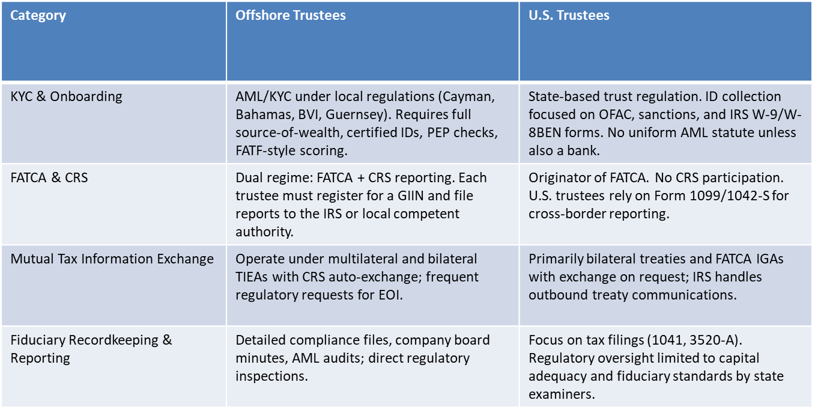
Practical Considerations
USA v The WORLD – who is winning the RING

Slide 10
Key Considerations
Practical – road Map for success
Practical Planning for international trusts
Legal – new document or existing document – direction of travel, who is making the decision
Assets – liquid assets v. illiquid assets
KYC – higher level of due diligence – Domestic v. International
Planning – dormant trust, decanting, distribution for existing trust to DE trust, distribution off shore
Removing the existing offshore trustee – indemnifications
Tax issues – international assets, international beneficiaries
Fiduciary Roles

Slide 11
Thank You

